Slide 1
Instructions for Taking the
Cybersecurity Concept Inventory (CCA)
Part of the Cybersecurity Assessment Tools (CATS) Project
Alan Sherman, Enis Golaszewski, Travis Scheponik, and Linda Oliva (UMBC)
{sherman, oliva}@umbc.edu
Geoffrey Herman, Seth Poulsen (U. Illinois)
glherman@illinois.edu
Peter A. H. Peterson (UMN Duluth)
pahp@d.umn.edu
Supported in part by the National Science Foundation under SFS capacity grant #1819521.

Slide 2
About the CCA
The Cybersecurity Curriculum Assessment (CCA) is a 25-question concept test for students who have completed an undergraduate major or track in cybersecurity
The CCA is not meant to be about specific technical knowledge, but rather general abilities critical for security reasoning and practice
Each multiple choice question has a scenario and a stem followed by five alternatives
Your task is always to choose the alternative that best answers the question

Slide 3
Why should you take the CCA?
You taking the CCA will help us improve it
The CCA will help identify better methods for teaching and learning cybersecurity
Taking the CCA will help you use your knowledge and adversarial thinking skills
You might enjoy the challenge!

Slide 4
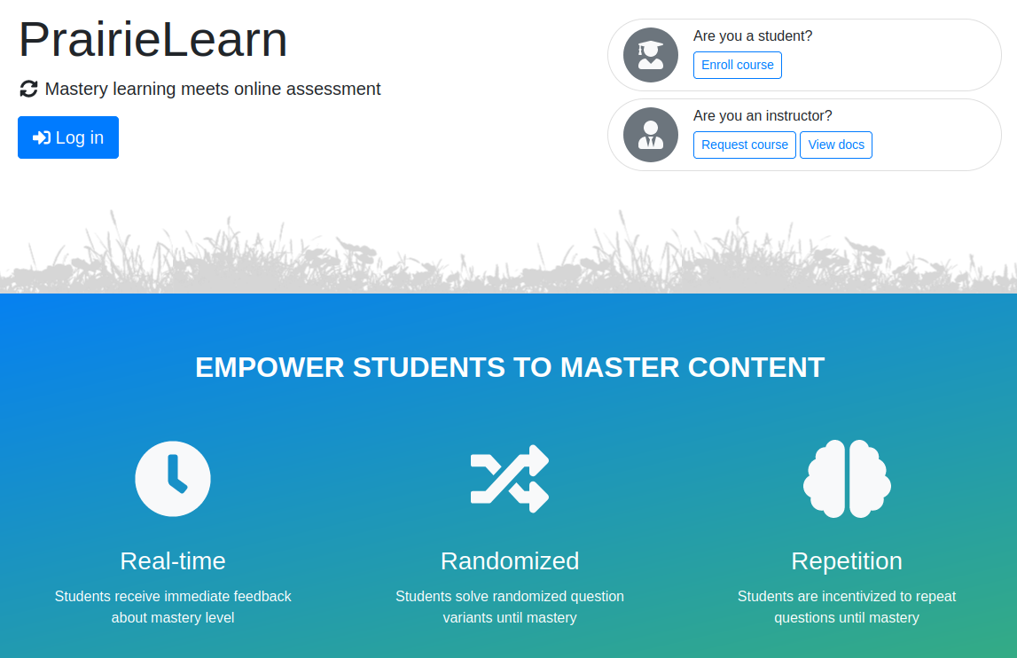
Get Started: Go to https://www.prairielearn.org/
Click here!
Click on “Enroll course” button.

Slide 5
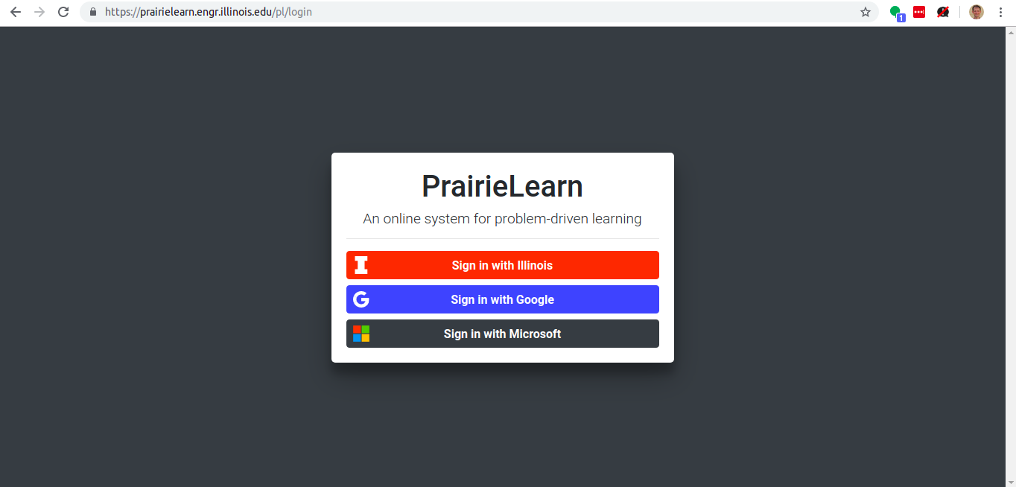
Choose an account to use
Sign in with a Google or Microsoft account.
Choose an account to use for identification (e.g., for extra credit)
No special account permissions are required

Slide 6
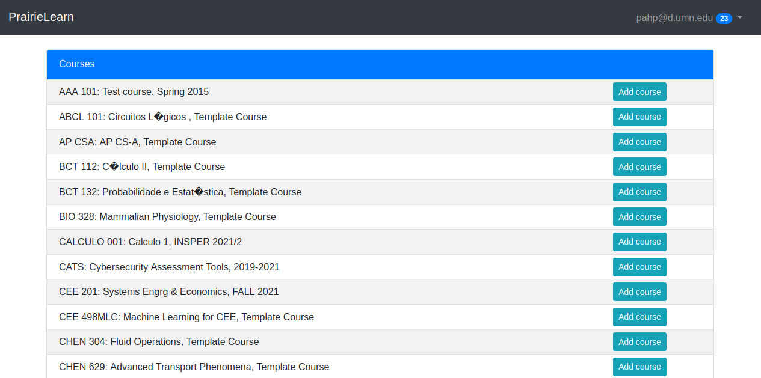
Choose a Course
Click “Add course” for CATS: Cybersecurity Assessment Tools,
… and confirm your choice. Note: The list is alphabetized; precise course title and list of courses may differ.

Slide 7
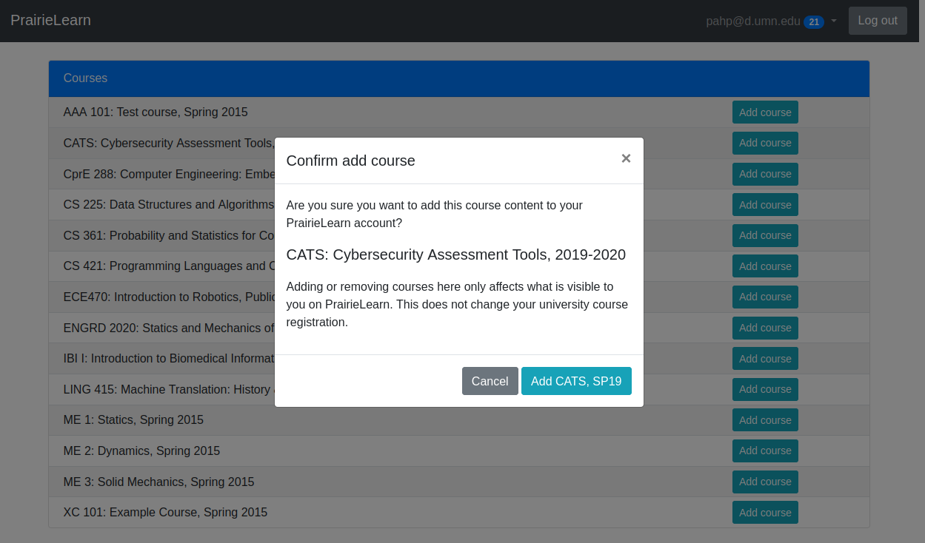
Confirm Course
If asked, confirm that you want to add the course.

Slide 8
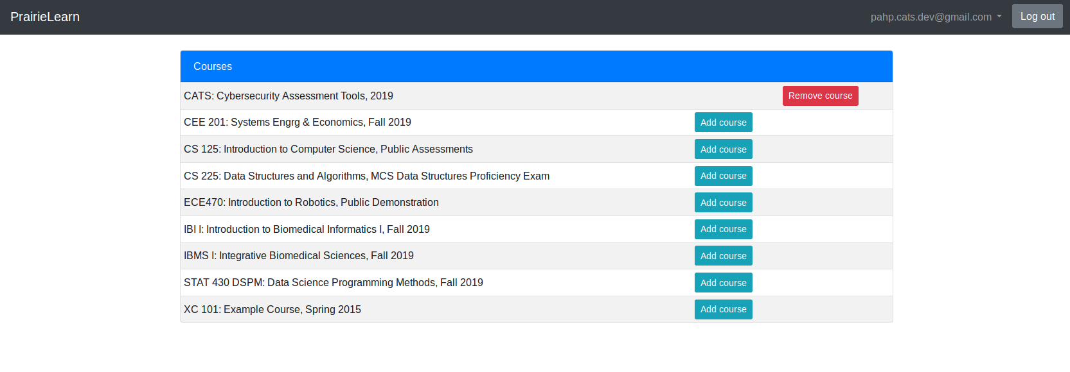
Go “Home”
Click on PrairieLearn in the upper left corner to access the “course” you just added.

Slide 9
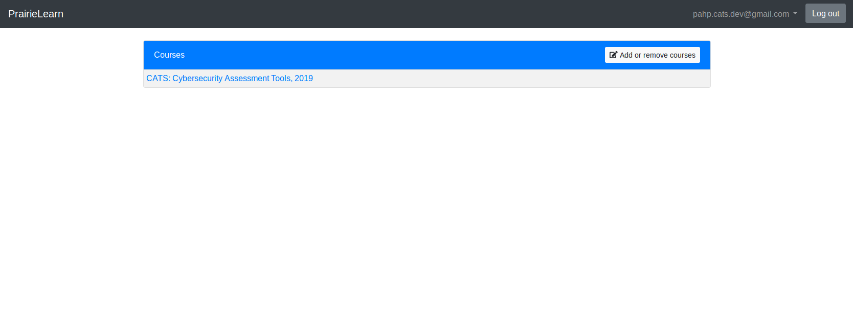
Choose Your New Course
Click on the CATS: Cybersecurity Assessment Tools course.
(Other courses may be listed if you are a PrairieLearn user.)

Slide 10
Select The CCA Assessment
Click on the “CCA cybersecurity college graduate” assessment.
Be sure to click on the correct assessment if multiple exist.

Slide 11
Agree to “Honor System”
If asked, verify your email address and check the box to signify that you will take the assessment on your own without any help. Then click Start assessment.

Slide 12
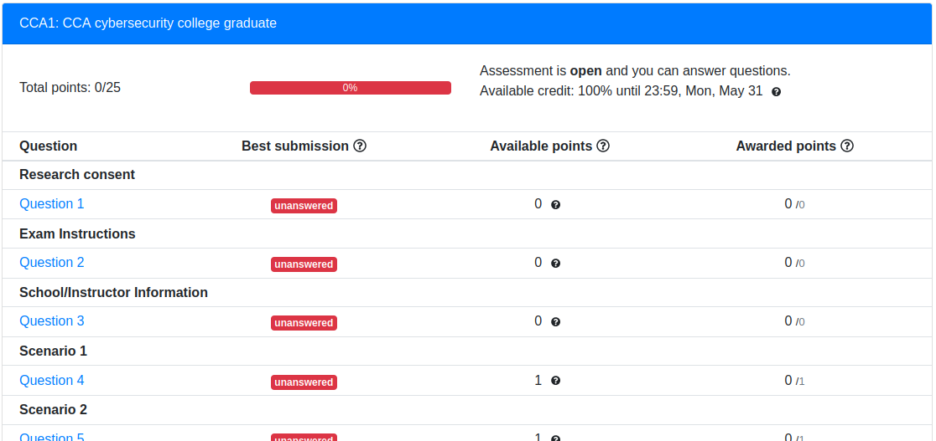
Begin the Assessment!
Click on the first item to read and agree to our consent form.

Slide 13
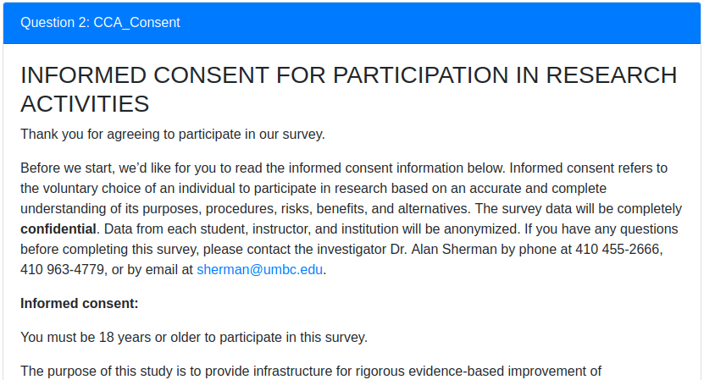
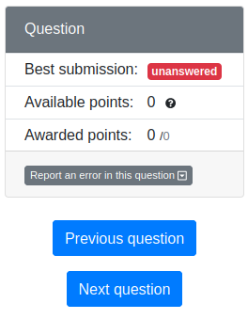
Consent Form
step three
...
step one
step two
Read and check the I Consent box, or quit by closing your browser. Then click Save only and, finally, Next question.

Slide 14
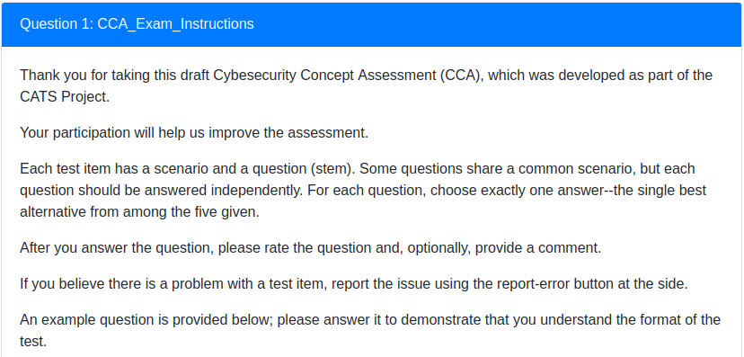
Instructions and Sample Question
Read the instructions for the exam.

Slide 15
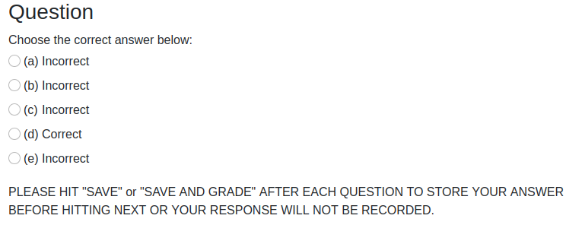
Answering the Sample Question
Click the “Correct” choice in the sample question.
Answers are randomized and may appear in a different location.
Next, click Save & Grade or just Save only:
(These buttons are at the bottom of every question.)

Slide 16
Going To The Next Question
After answering and saving an answer, click Next question

Slide 17
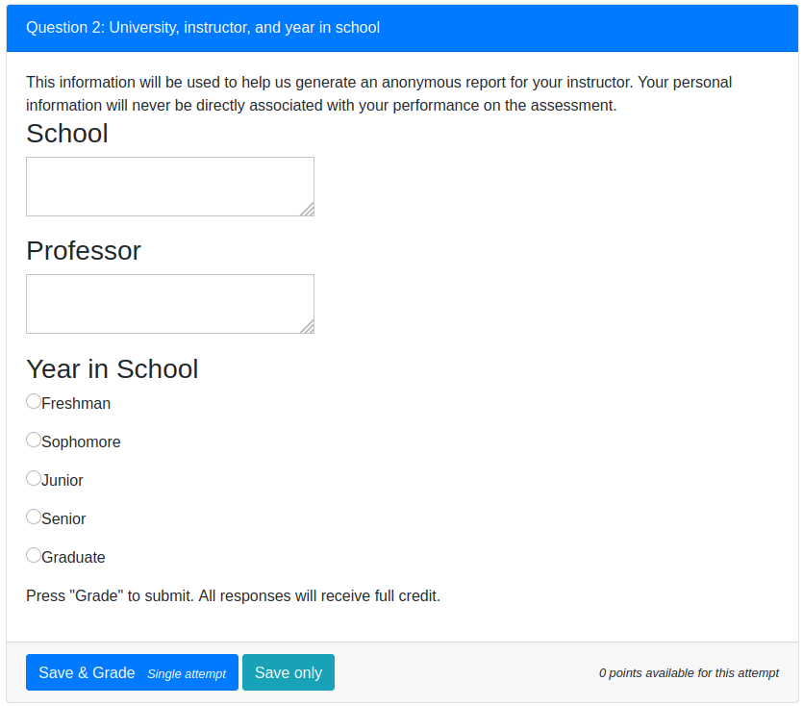
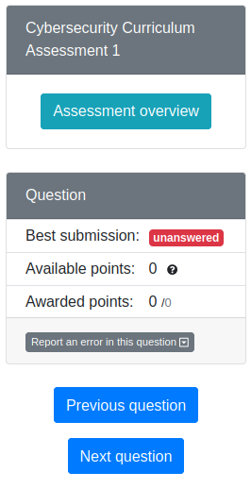
School Information
Answer the information about your school so we can provide anonymous feedback to your instructor (e.g., for extra credit).
(Remember to press Save & Grade or just Save and Next question)

Slide 18
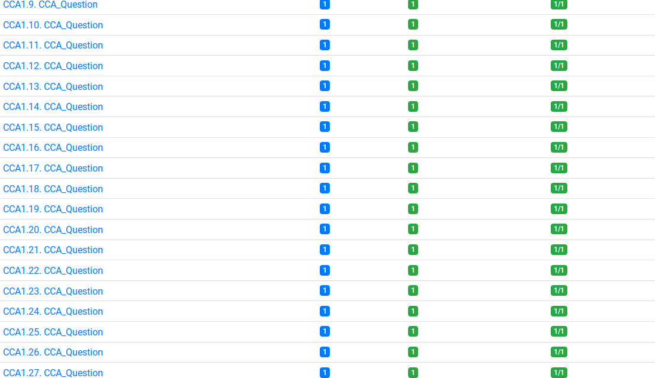
Answer all 25 questions!
Go through the rest of the test!
=
Remember to press Save & Grade or Save after each answer!

Slide 19
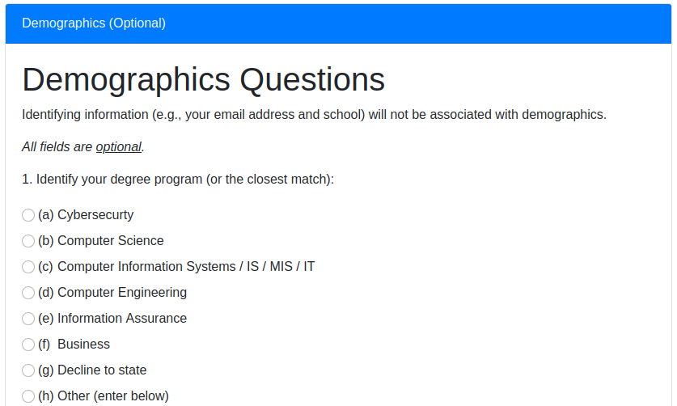
Answer (optional) Demographics Survey
Your answers will be used anonymously to help improve the test for others.

Slide 20
Thank you very much!
Get started now at https://www.prairielearn.org
Have questions or want to help? Email sherman@umbc.edu.

